Slide 1
ONLINE LIBRARY MANAGEMENT SYSTEM OF AN INSTITUTE
Presented by:
Abhishek Maurya (1901002)
Ravikant Sharma (1901053)
Shivank Bhardwaj (1901066)

Slide 2
INTRODUCTION
Online Library Management System is an application which refers to library systems which are generally small or medium in size. It is used by librarians to manage the library using a computerized system where he/she can record various transactions like issue of books, return of books, addition of new books, addition of new students etc. Books and student maintenance modules are also included in this system which would keep track of the students using the library and also a detailed description about the books a library contains. With this computerized system there will be no loss of book record or member record which generally happens when a non computerized system is used.

Slide 3
SYSTEM OBJECTIVE
Improvement in control and performance: The system is developed to cope up with the current issues and problems of library .The system can add user, validate user and is also bug free.
Save cost: After computerized system is implemented less human force will be required to maintain the library thus reducing the overall cost.
Save time: Librarian is able to search record by using few clicks of mouse and few search keywords thus saving his valuable time.

Slide 4
SOFTWARE TOOLS USED
1. FRONT END
i) HTML:-HTML or Hyper Text Markup Language is the main designing language to create this web app and other information that can be displayed in a web browser.
ii) CSS:- CSS stands for Cascading Style Sheets. It enhance the UI design of any web page.
iii)BOOTSTRAP:-It is HTML, CSS and JavaScript framework which is free and open source tool collection for creating responsive website and web applications
2. BACK END
i) JAVA:- JAVA is an interpreter based, object-oriented, high-level programming language with dynamic semantics. Here we used it as a back-end programming language.
ii) JAVA SERVER PROGRAMMING:- A JSP page consists of HTML tags and JSP tags. The JSP pages are easier to maintain than Servlet because we can separate designing and development. It provides some additional features such as Expression Language, Custom Tags, etc.
iii) Oracle:-Oracle Database is a multi-model database management system produced and marketed by Oracle Corporation. It is a database commonly used for running online transaction processing, data warehousing and mixed database workloads.
We also used some other tools like NETBEANS editor etc.

Slide 5
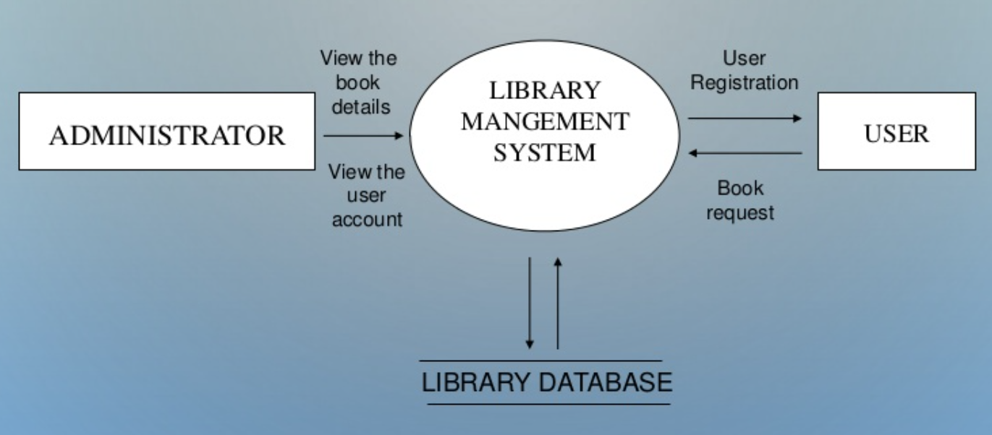
ANALYSIS MODEL

Slide 6
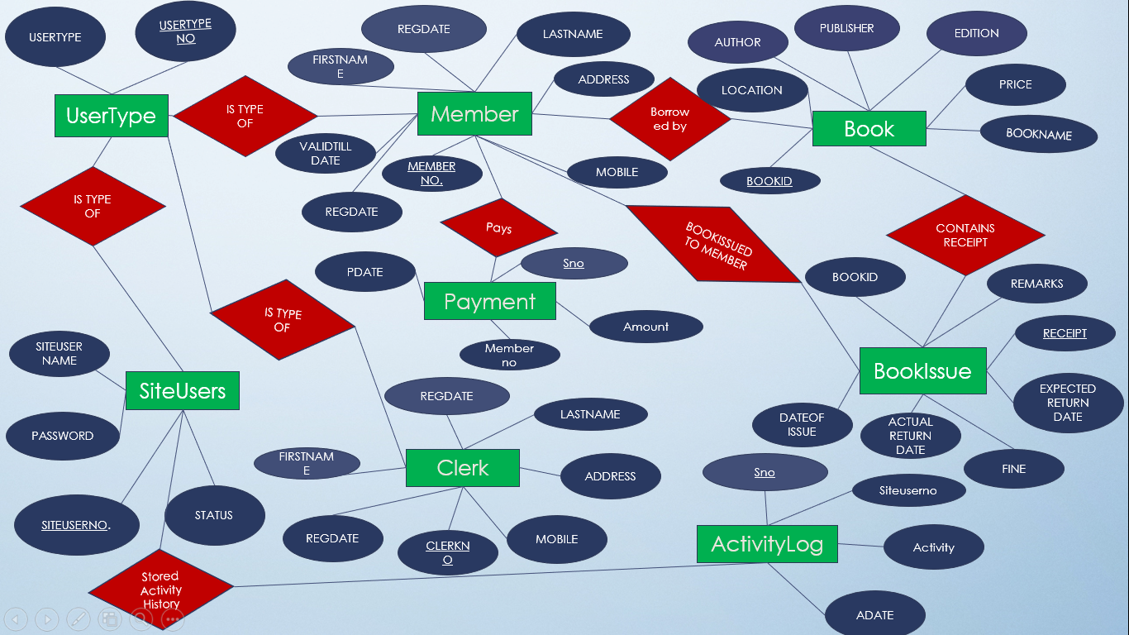
ER DIAGRAM

Slide 7
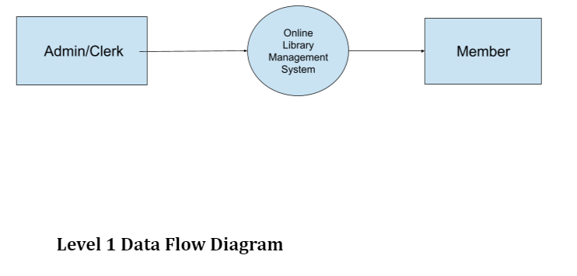
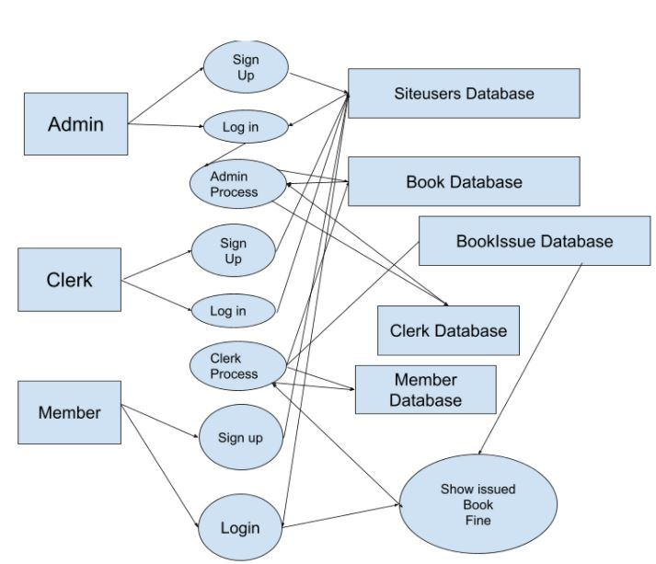
Data Flow Diagram
Level 2 Data Flow Diagram

Slide 8
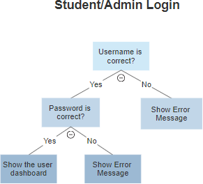
LOGIN DECISION TREE

Slide 9
UserTypes Table
Tables in Database:
Field Name | Data Type | Comment
USERTYPENO | Number | PRIMARY KEY
USERTYPE | Varchar2 (50) | UNIQUE , NOT NULL

Slide 10
SiteUsers Table
Field Name | Data Type | Comment
SITEUSERNO | Number | PRIMARY KEY
SITEUSERNAME | Varchar2 (16) | UNIQUE, NOT NULL
PASSWORD | Varchar2 (16) | NOT NULL
USERTYPENO | Number | NOT NULL
STATUS | Varchar2 (30) | NOT NULL

Slide 11
Members Table
Field Name | Data Type | COMMENT
MEMBERNO | NUMBER | PRIMARY KEY
FIRSTNAME | Varchar2 (20) | NOT NULL
LASTNAME | Varchar2 (20) | NOT NULL
USERTYPENO | Number | REFRENCES USERTYPES(USERTYPENO), NOT NULL
ADDRESS | Varchar2 (80) | NOT NULL
REGDATE | Date (7) | NOT NULL
VALIDTILLDATE | Date (7) | NOT NULL
MOBILE | Varchar2 (10) | NOT NULL
SITEUSERNO | Number | REFRENCES SITEUSERS( SITEUSERNO)

Slide 12
Clerk Table
Field Name | Data Type | COMMENT
CLERKNO | NUMBER | PRIMARY KEY
FIRSTNAME | Varchar2 (20) | NOT NULL
LASTNAME | Varchar2 (20) | NOT NULL
USERTYPENO | Number | REFRENCES USERTYPES(USERTYPENO), NOT NULL
ADDRESS | Varchar2 (80) | NOT NULL
REGDATE | Date (7) | NOT NULL
MOBILE | Varchar2 (10) | NOT NULL
SITEUSERNO | Number | REFRENCES SITEUSERS( SITEUSERNO)

Slide 13
Books Table
Field Name | Data Type | Comment
BOOKID | Number | PRIMARY KEY
BOOKNAME | Varchar2 (60) | NOT NULL
PUBLISHER | Varchar2 (50) | NOT NULL
AUTHER | Varchar2 (50) | NOT NULL
PRICE | Number | NOT NULL
EDITION | Varchar2 (10) | NOT NULL
LOCATION | Number | REFRENCES MEMBERS(MEMBERNO)

Slide 14
BookIssue Table
Field Name | Data Type | Content
RECEIPT | Number | Primary Key
USERID | Number | REFERENCES MEMBERS( MEMBERNO)
BOOKID | Number | NOT NULL
DATEOFISSUE | Date | NOT NULL
EXPECTEDRETURNDATE | Date (7) | NOT NULL
ACTUALRETURNDATE | Date (7)
REMARKS | Varchar2 (40)
FINE | Number | NOT NULL
EXTRAFINE | Number | NOTNULL

Slide 15
Payments Table
Field Name | Data Type | Comment
SNO | Number | PRIMARY KEY
MEMBERNO | NUMBER | REFERENCES MEMBERS (MEMBERNO) NOT NULL
AMOUNT | Number | NOT NULL
PDATE | DATE | NOT NULL

Slide 16
ActivityLog Table
Field Name | Data Type | Comment
SNO | Number | PRIMARY KEY
SITEUSERNO | Number | REFERENCES SITEUSERS(SITEUSERNO), NOT NULL
ACTIVITY | VARCHAR(300) | NOT NULL
ADATE | DATE | NOT NULL

Slide 17
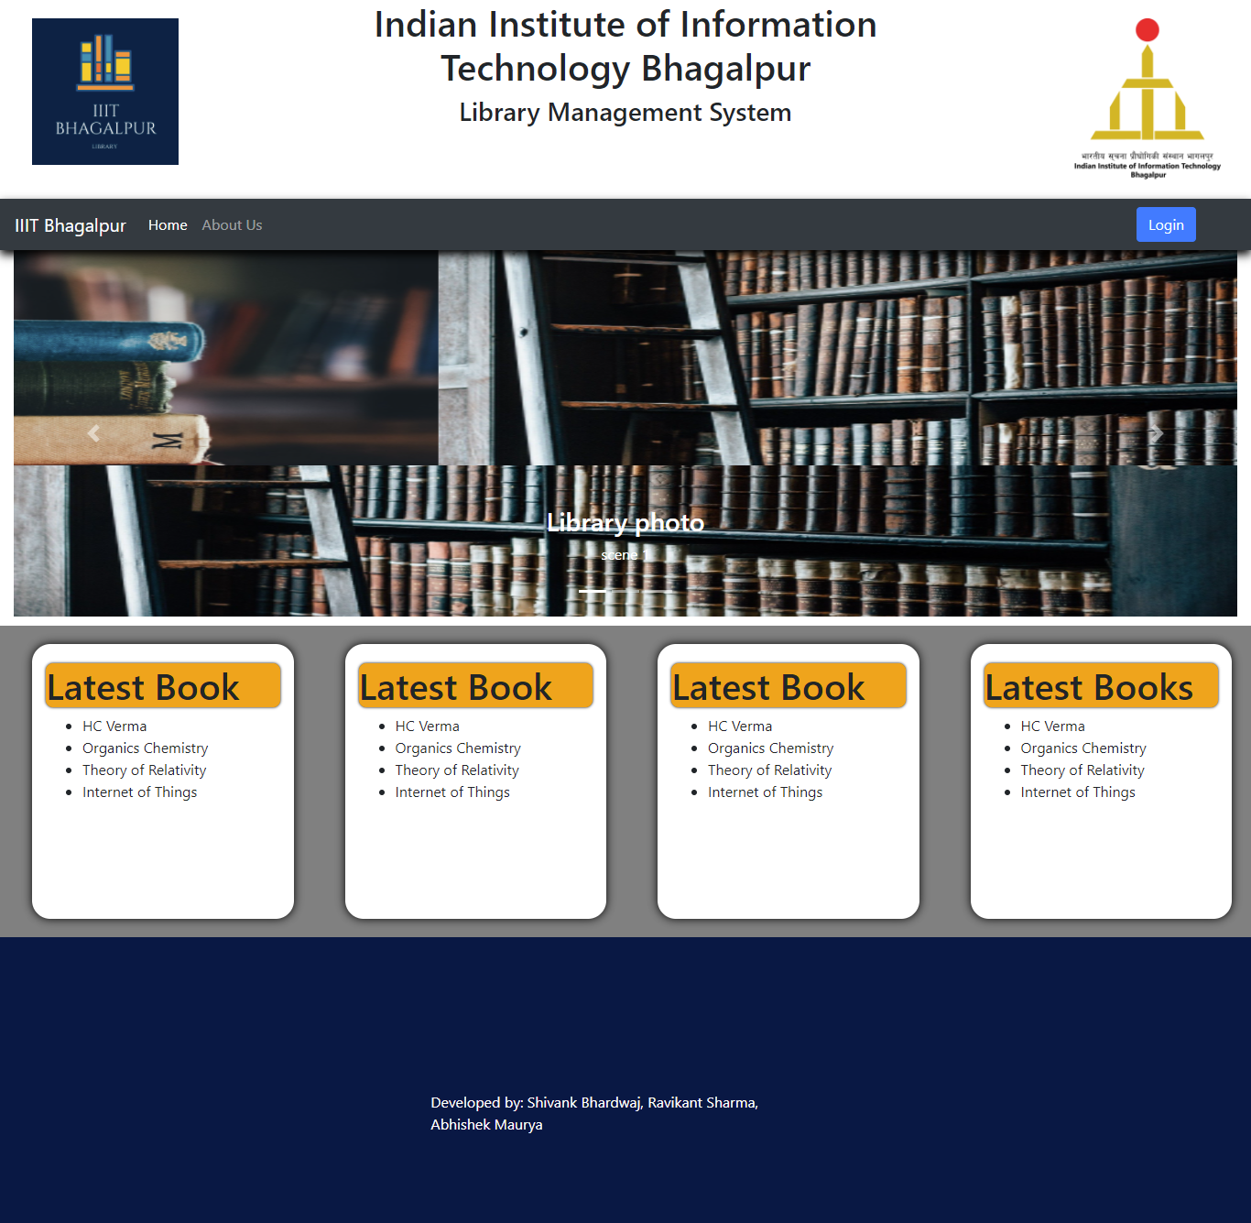
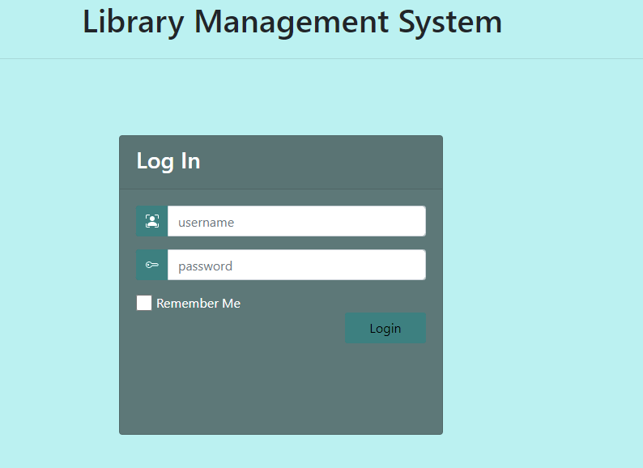
UI(Front-End)

Slide 18

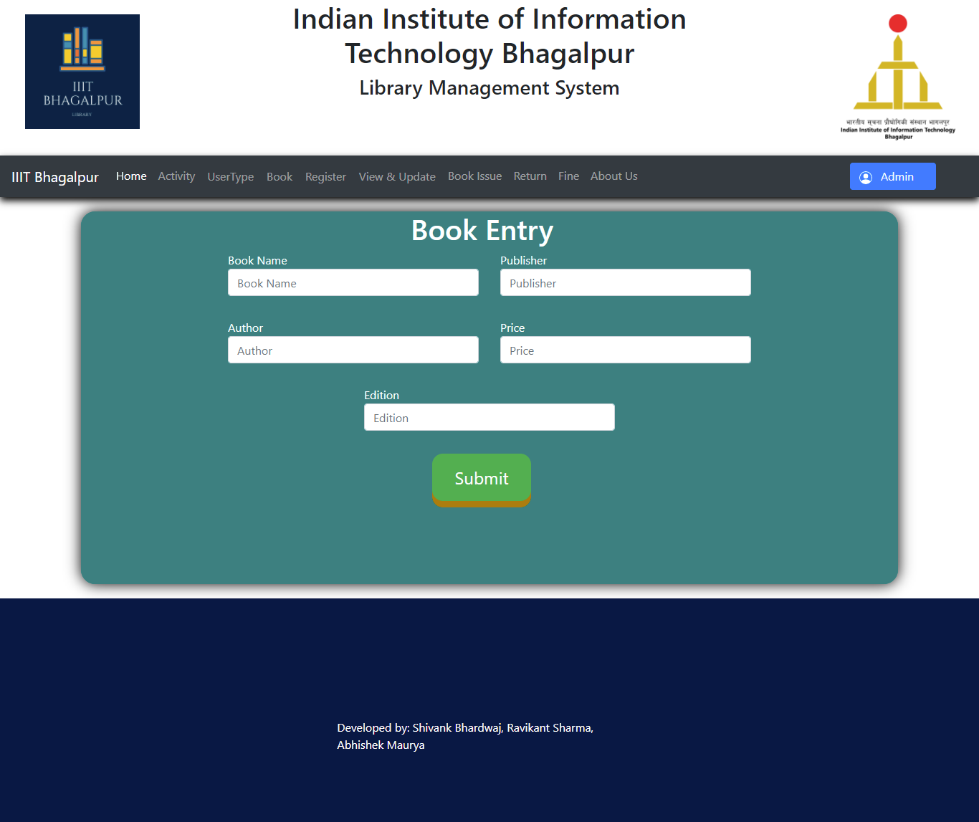

Slide 19
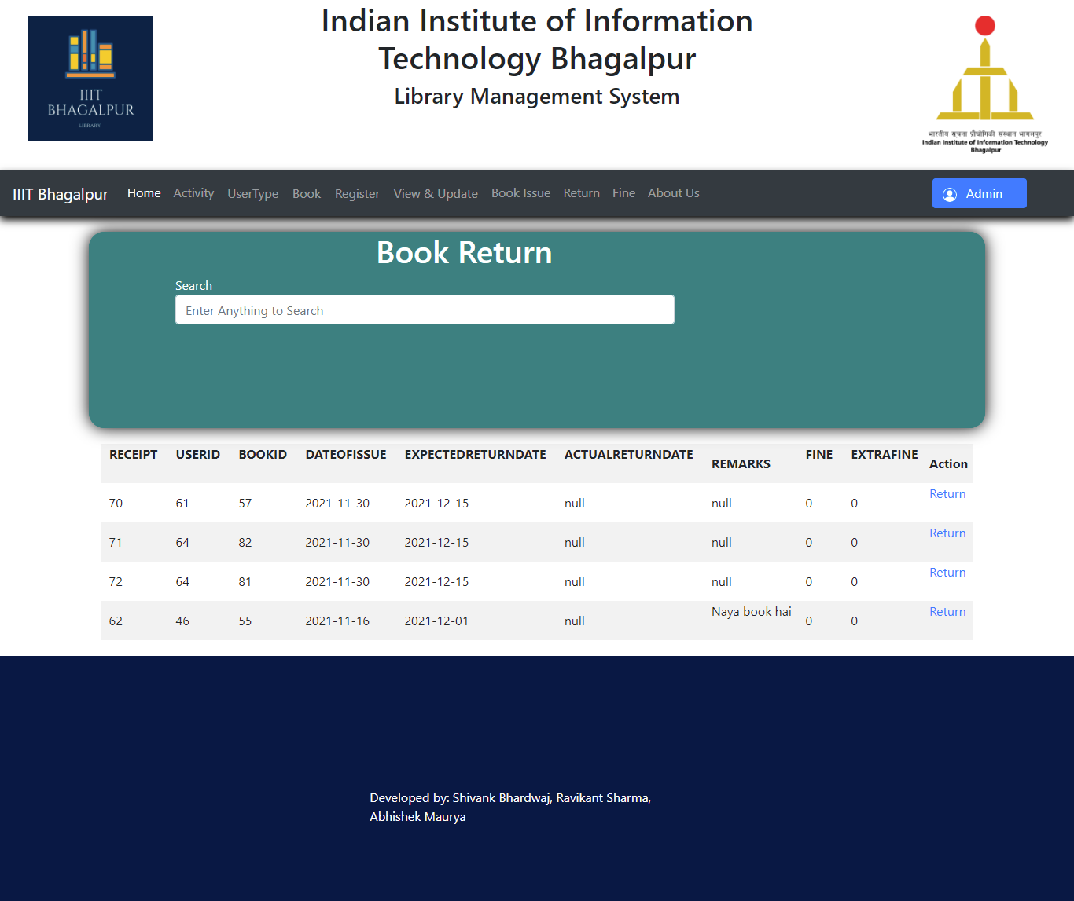
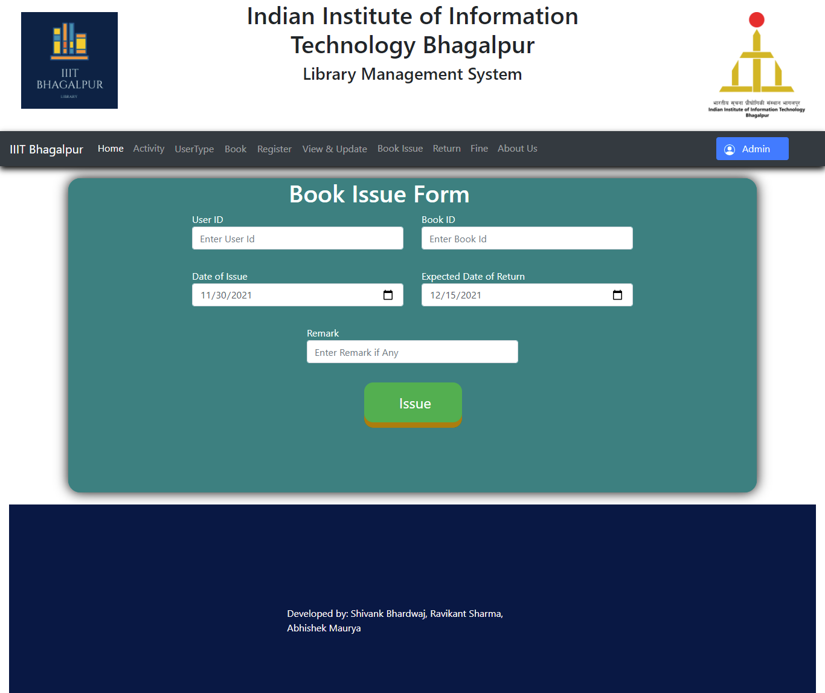

Slide 20
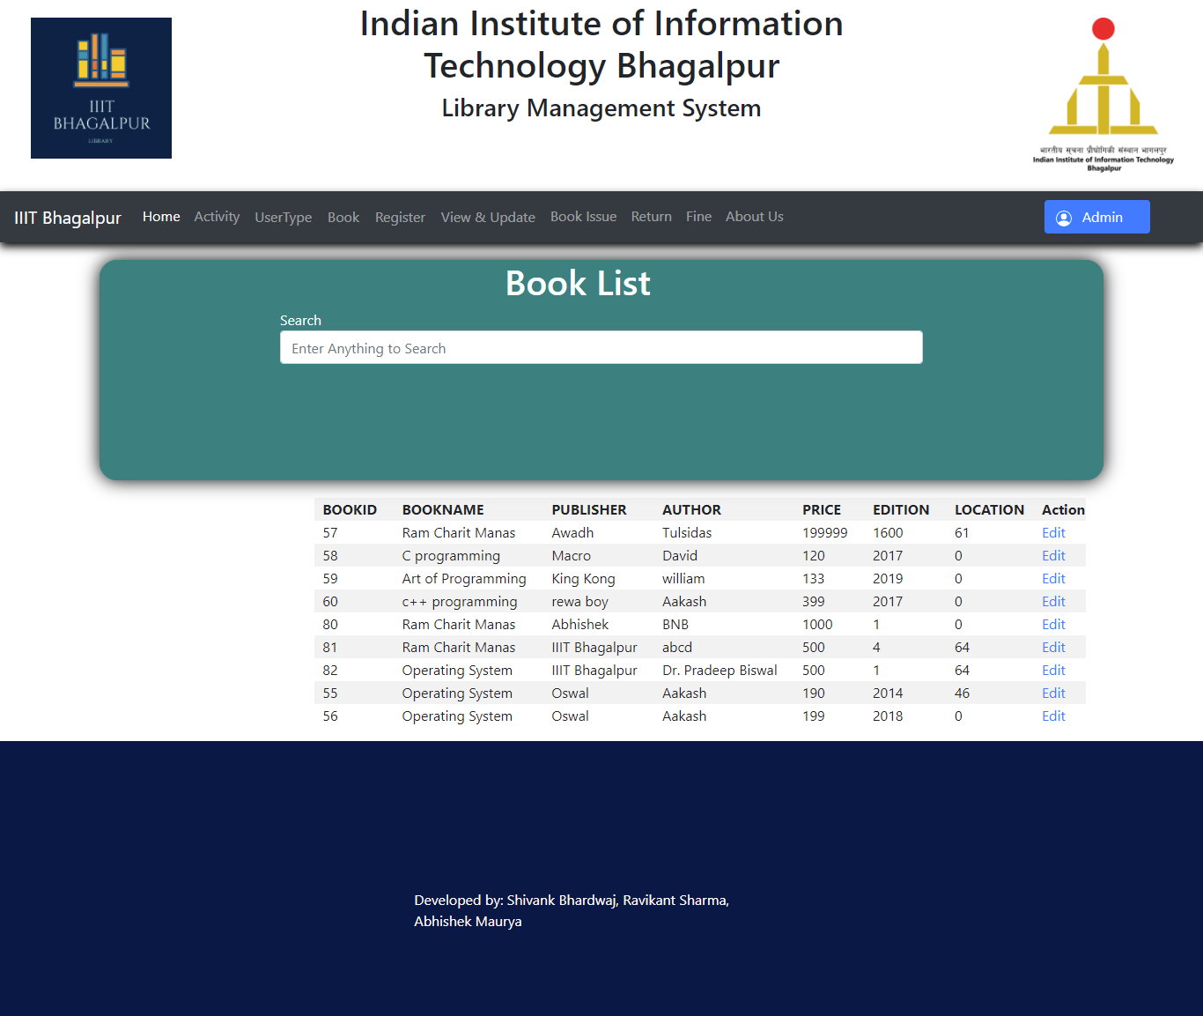
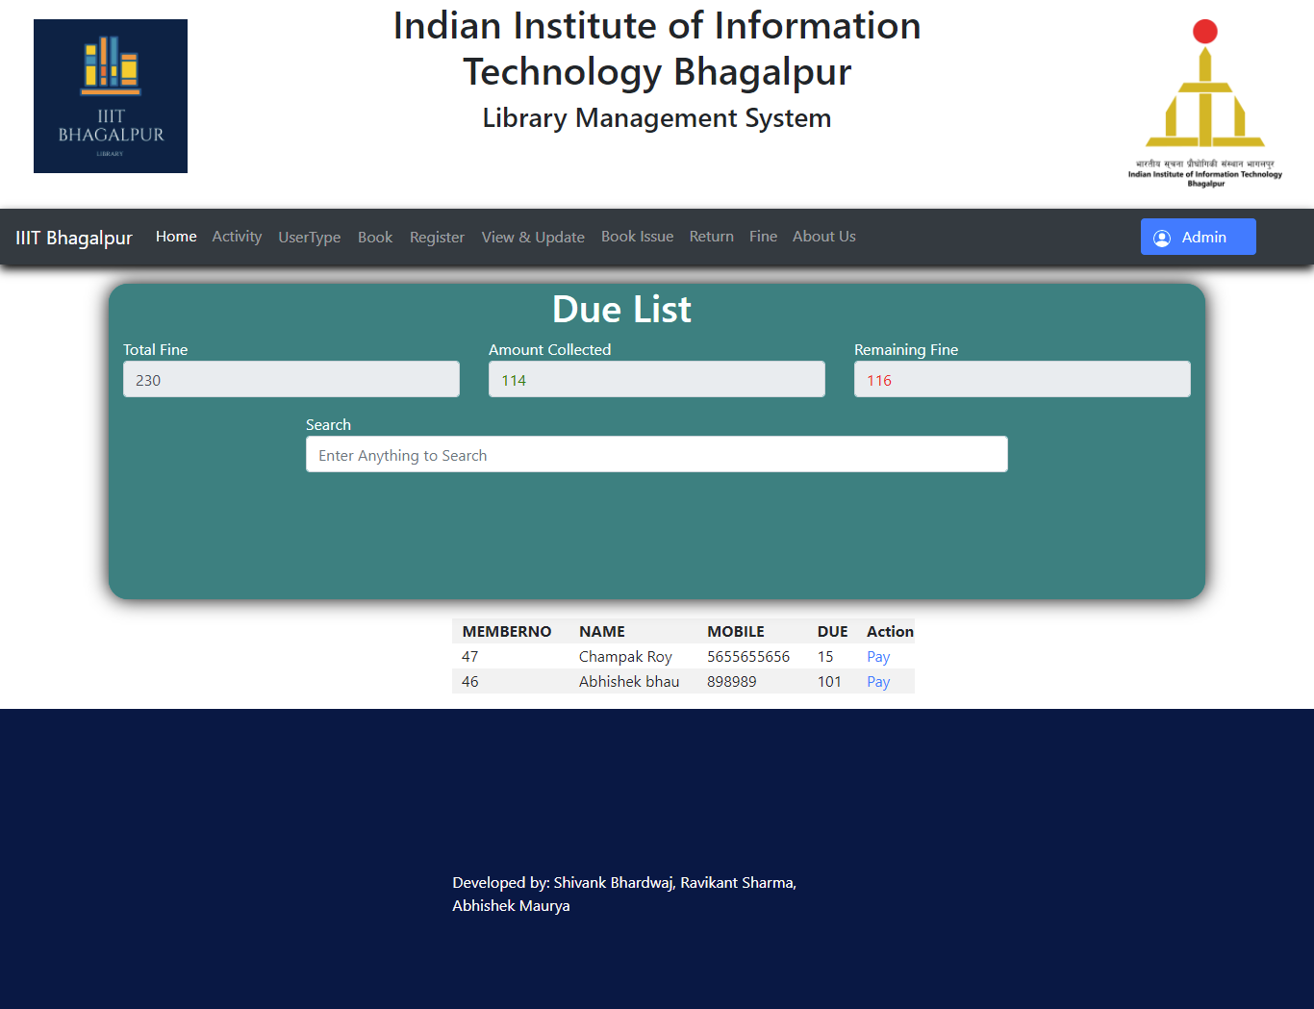

Slide 21
THANK YOU

